Slide 1
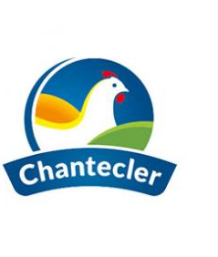
Avipro Co. Ltd company of the Eclosia Group, is a pioneer in the poultry sector in Mauritius. Its main activities are breeding and production, grouped respectively under the Farming and Processing entities.
WE ARE RECRUITING
Production Assistant
Main duties and responsibilities
Profile
• In collaboration with the Production Officer, oversee and ensure the smooth running of production activities.
• Coordinate the different phases of the process by effective and efficient allocation of tasks within one or more teams.
• Ensure compliance with deadlines, quantities, quality and costs. Manage and control the use of equipment.
• Ensure that instructions for safety and quality are well respected in the day to day.
• Manage and control the traffic and flow of raw materials.
• Monitoring the productivity index of production lines and ensuring that operations are carried out optimally.
• Recommend changes in workflow, operations and equipment to maximize production efficiency.
• Diploma in Food Science/Production & Operations Management.
• Computer literate with good knowledge of MO tools.
• Health & Safety and Quality conscious.
• Excellent communication and interpersonal skills.
• Reliable, with a team spirit and ‘Can do’ attitude.
• At least one year experience in a manufacturing/ production or similar industry. • Knowledge of the food production industry will be a definite advantage.
• Ability to work on night shifts.
• Holder of a valid driving license.
• Promoter of animal welfare.
Interested candidates should forward their resume by latest 15th May 2025 to Avipro Co. Ltd – Processing Plant, Pont-Fer, Phoenix | Tel: 6863094| Email : hrprocessing.avipro@eclosia.com
Only the best candidates will be called for an interview.

